Slide 1
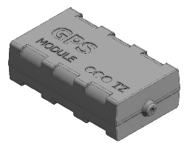
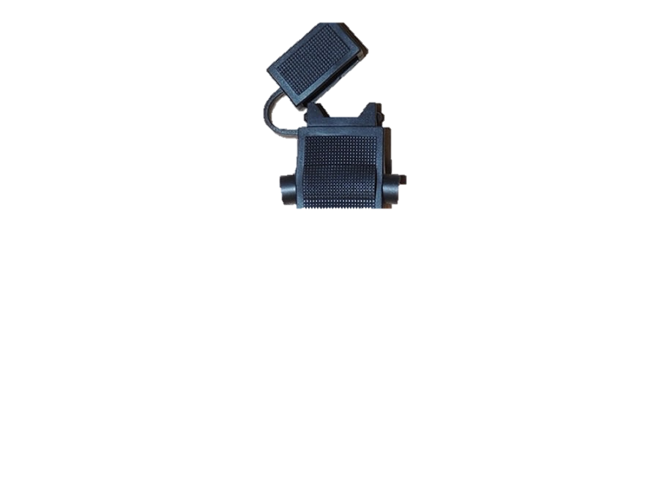
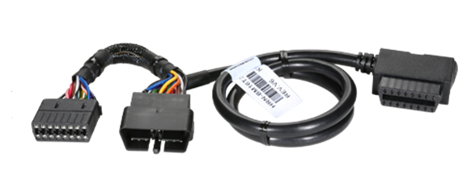
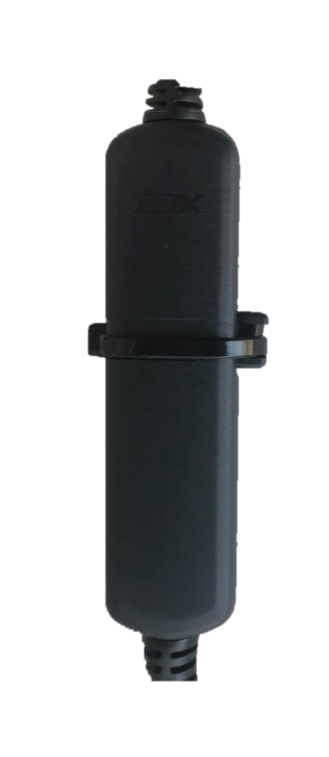

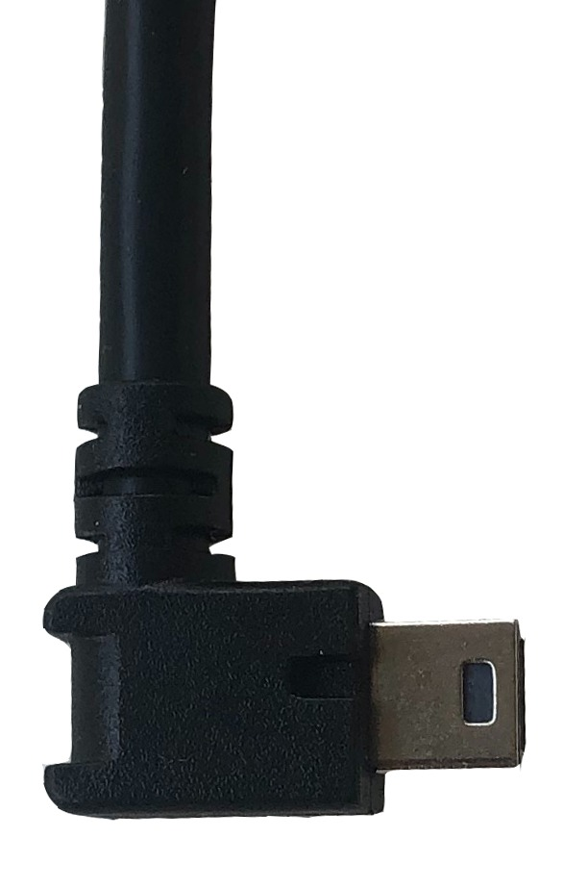
DECOY INTALLATION DIAGRAM
FUSE
(+) 12 - 24V
(-) GND
DECOY
FUSE
IOX-AUXM
ARNES HRN-GS16K2
(o HRN-CW03K3)
GO9

Slide 2
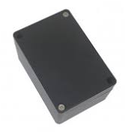
DECOY INTALLATION DIAGRAM
AND CUT MODULE
FUSE
(+) 12 - 24V
(-) GND
DECOY
FUSE
FUSE
ARNES HRN-GS16K2
(o HRN-CW03K3)
IOX-AUXM
CUT MODULE
FUEL CUT/
CURRENT/IGNITION
GO9
M

